Slide 1


COMPSYS 302
Java Game
Group 2
KyungHo (Michael) Chun
TaeYoung Hwang

Slide 2




Overview
Recreation of Warlord’s Game with a retro theme and modernized game features + performance.
Started with creating the basis of the warlord’s game such as the ball, paddles and collision detection.
After the base was complete, other bonus design features were added.

Slide 3

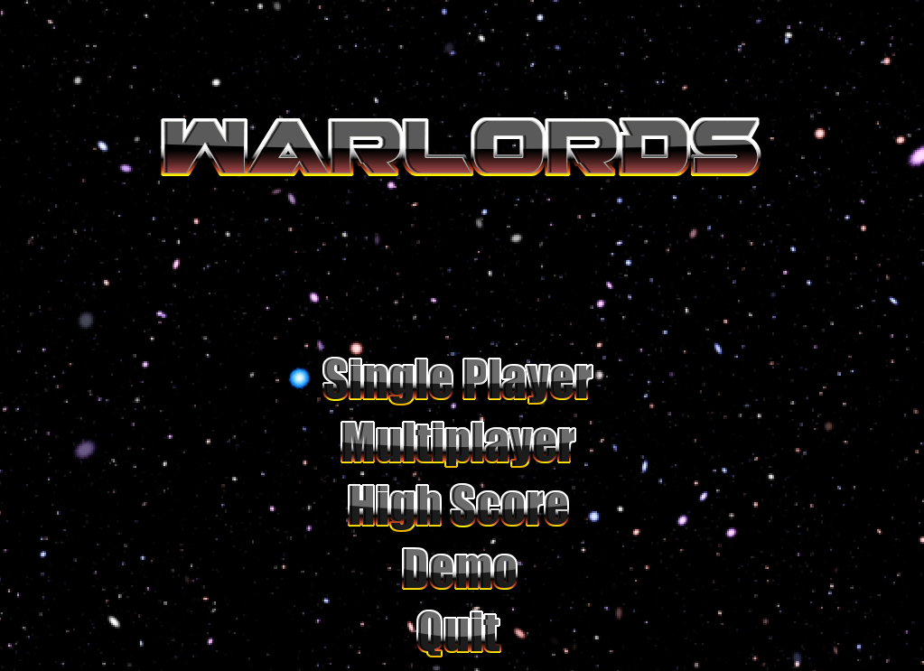
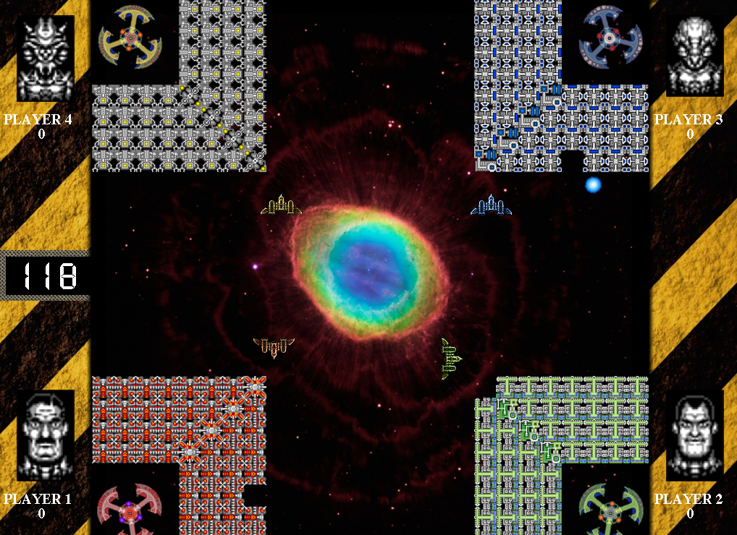
Rendered Screen

Slide 4
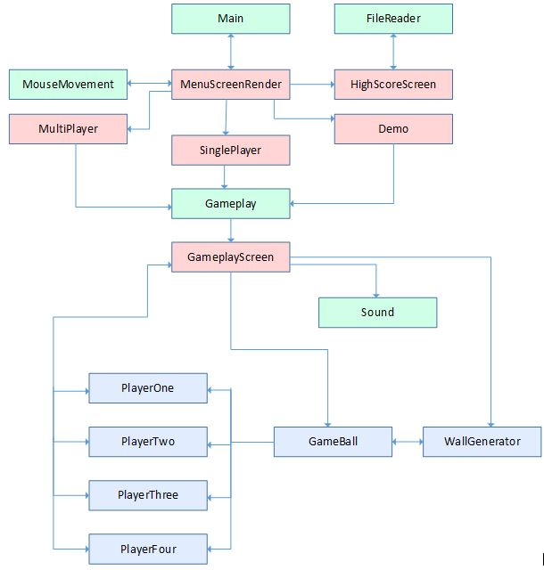



Top Level View of System

Slide 5
Game Functionality
Game functionality will now be demonstrated through my laptop
Navigating through the menu – by mouse and keyboard
Countdown – paddles are unable to move
Timer starting from 120 seconds
Sound effects
Collision detection between all object intersections (walls, paddles)
Ball does not randomly disappear out of screen
Player death – Paddle and King disappears
Win conditions – Either one player remaining or 2 minutes has passed
Pausing the game and exiting

Slide 6
Special Features
Score Function
Can spawn balls onto screen to increase gameplay
New ball spawns every time a player dies
Retro themed images and sounds
Demo Mode
2,3,4 multiplayer modes
Mouse click input
High score screen – reading from a text file

Slide 7


Our Game
Aesthetically pleasing graphics
Retro themed sound effects
Interactive with the players (2,3,4 multiplayer modes + spawn balls at will)
Nostalgic for older players i.e client
Addicting and a newer retro experience for younger players i.e client’s son

Slide 8



Worth of the Game
Custom made for a customer
First professional project
Time spent on the project

